Slide 1

Library Management System
Utilizing React, Electron, Node.js, TypeScript, Firebase

Slide 2
Table of Contents
Introduction
Problem Statement
Solution
Technologies Used
Key Features
Future Enhancement
Conclusion

Slide 3

1
Introduction
The Library Management System (LMS) is an automated solution that automates all library functions, from book issuance to returns.
Provides an intuitive platform for managing library resources.
A system which ensures accurate and timely data.
Streamlines enhanced Book and User management.

Slide 4

2
Problem Statement
Manual library management systems are often inefficient and prone to errors.
There is a need for a digital solution to handle the increasing volume of users and books.
Current systems lack real-time data updates and user-friendly interfaces.

Slide 5

3
Solution
A digital platform designed to improve library operations.
Integrates advanced technologies to provide real-time data updates.
Enhances user experience with intuitive interfaces and efficient processes.
Ensures accurate tracking and updating of book inventories and user activities.

Slide 6
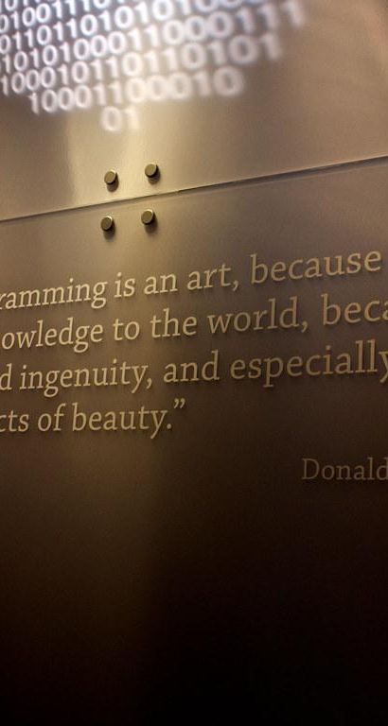
4
Technologies Used
Frontend
React
Material UI
Backend
Node Js
DataBase
Firebase Firestore

Slide 7
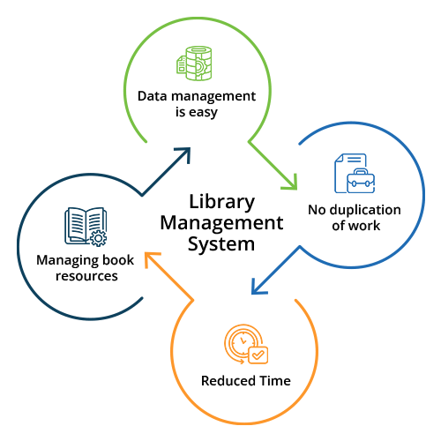
5
Key Features
Dashboard
User Management
Book Management
Issue Books
View Issued Books
Return Books

Slide 8
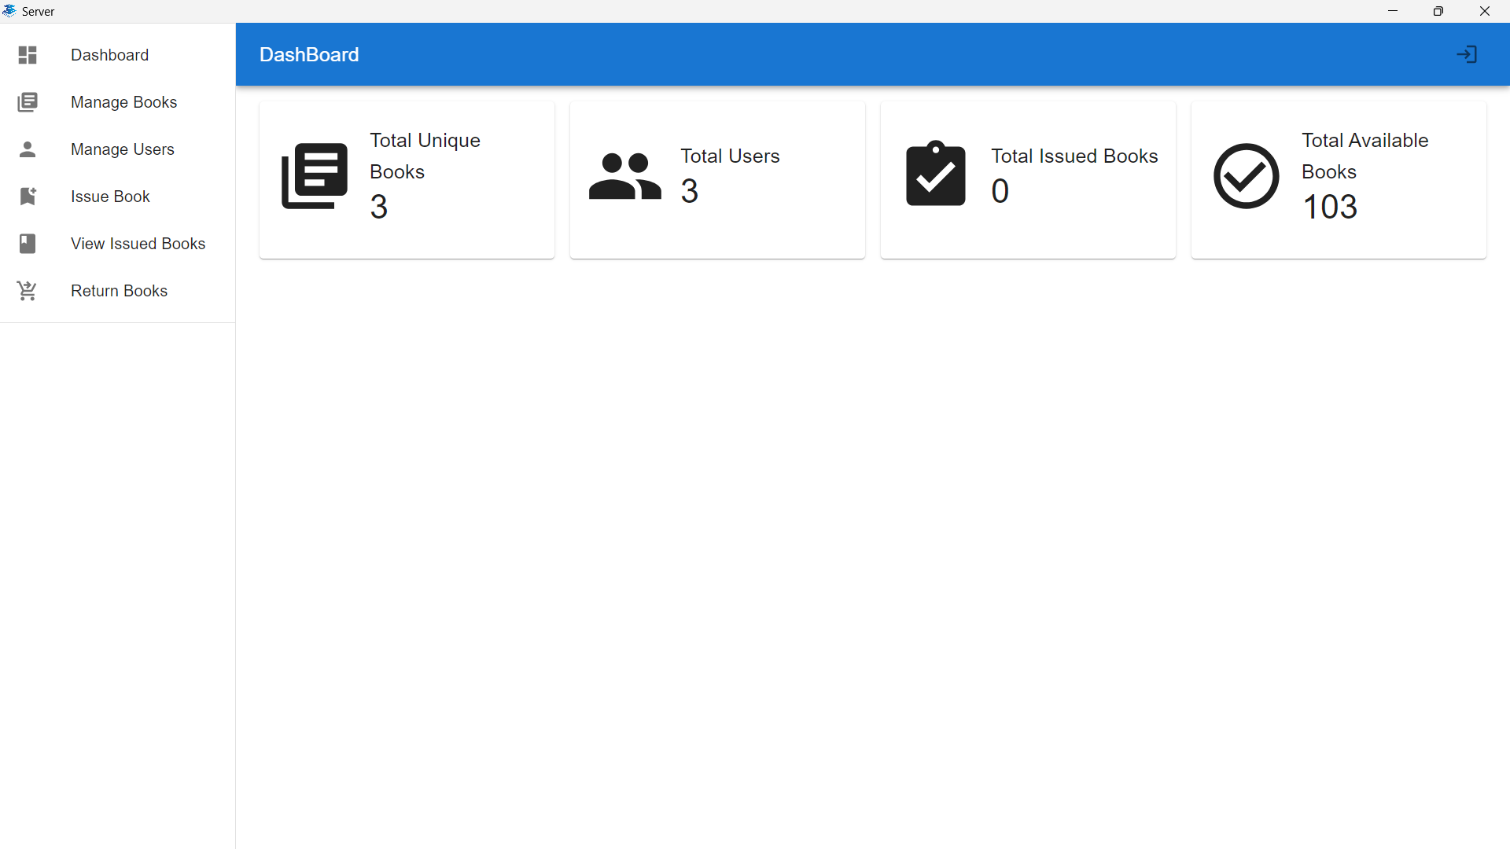
5
DashBoard

Slide 9
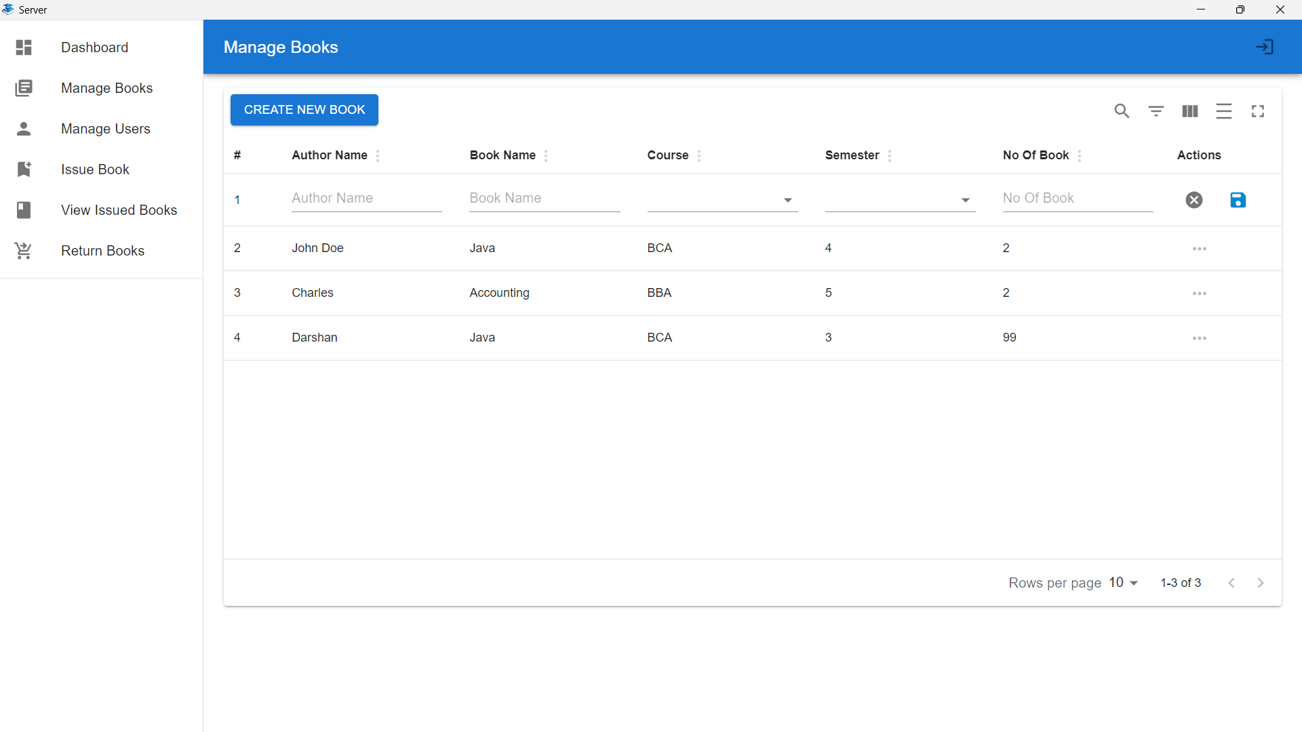
5
Manage Books

Slide 10
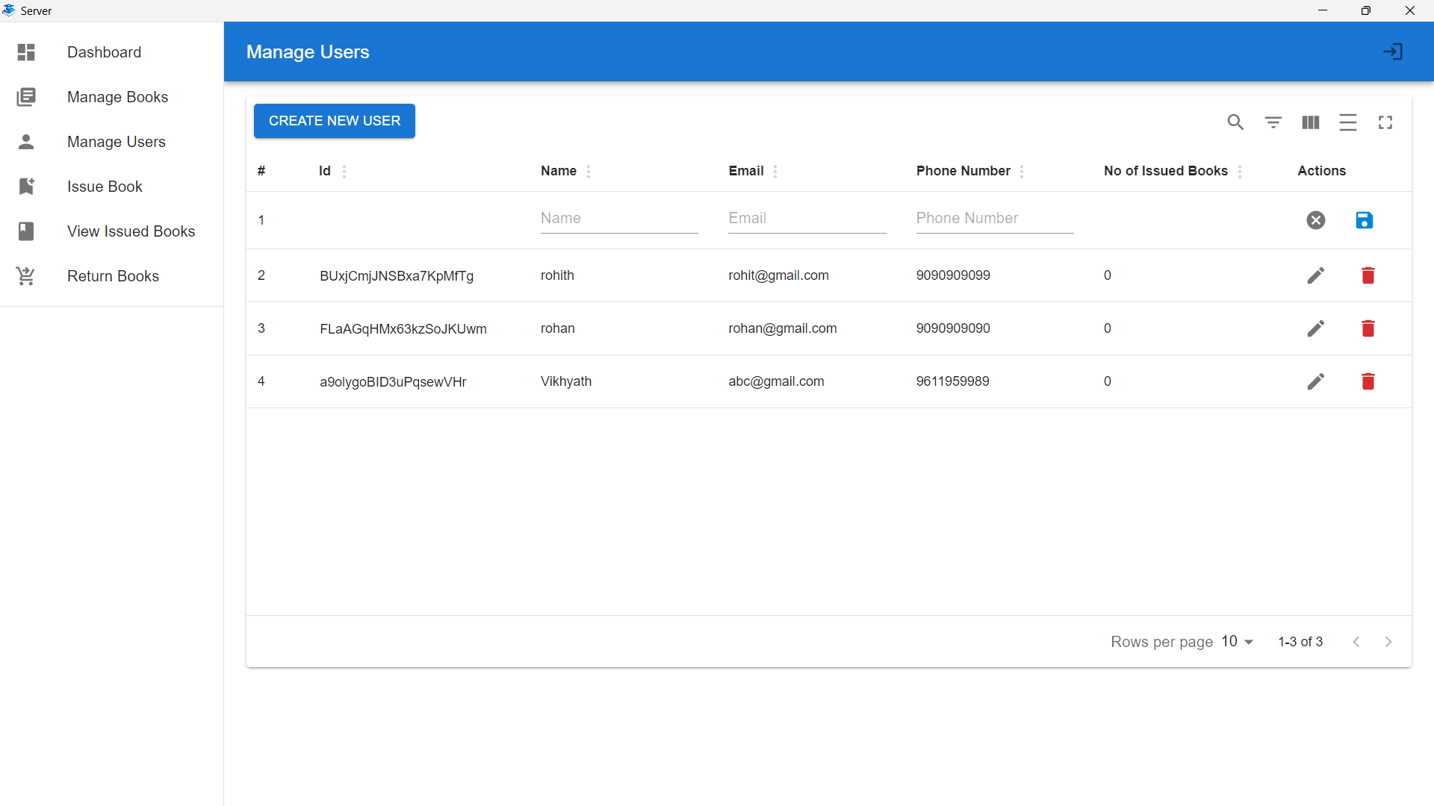
5
Manage Users

Slide 11
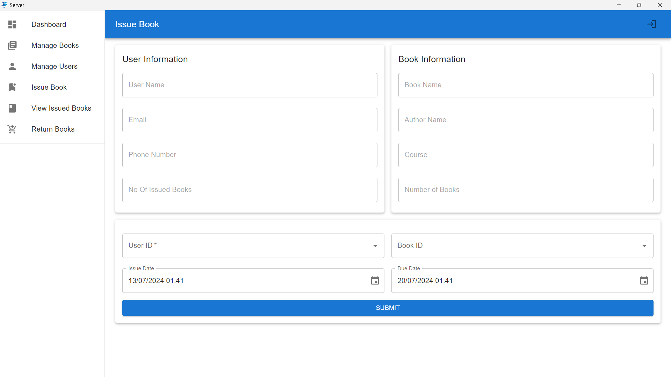
6
5
Issue Book

Slide 12
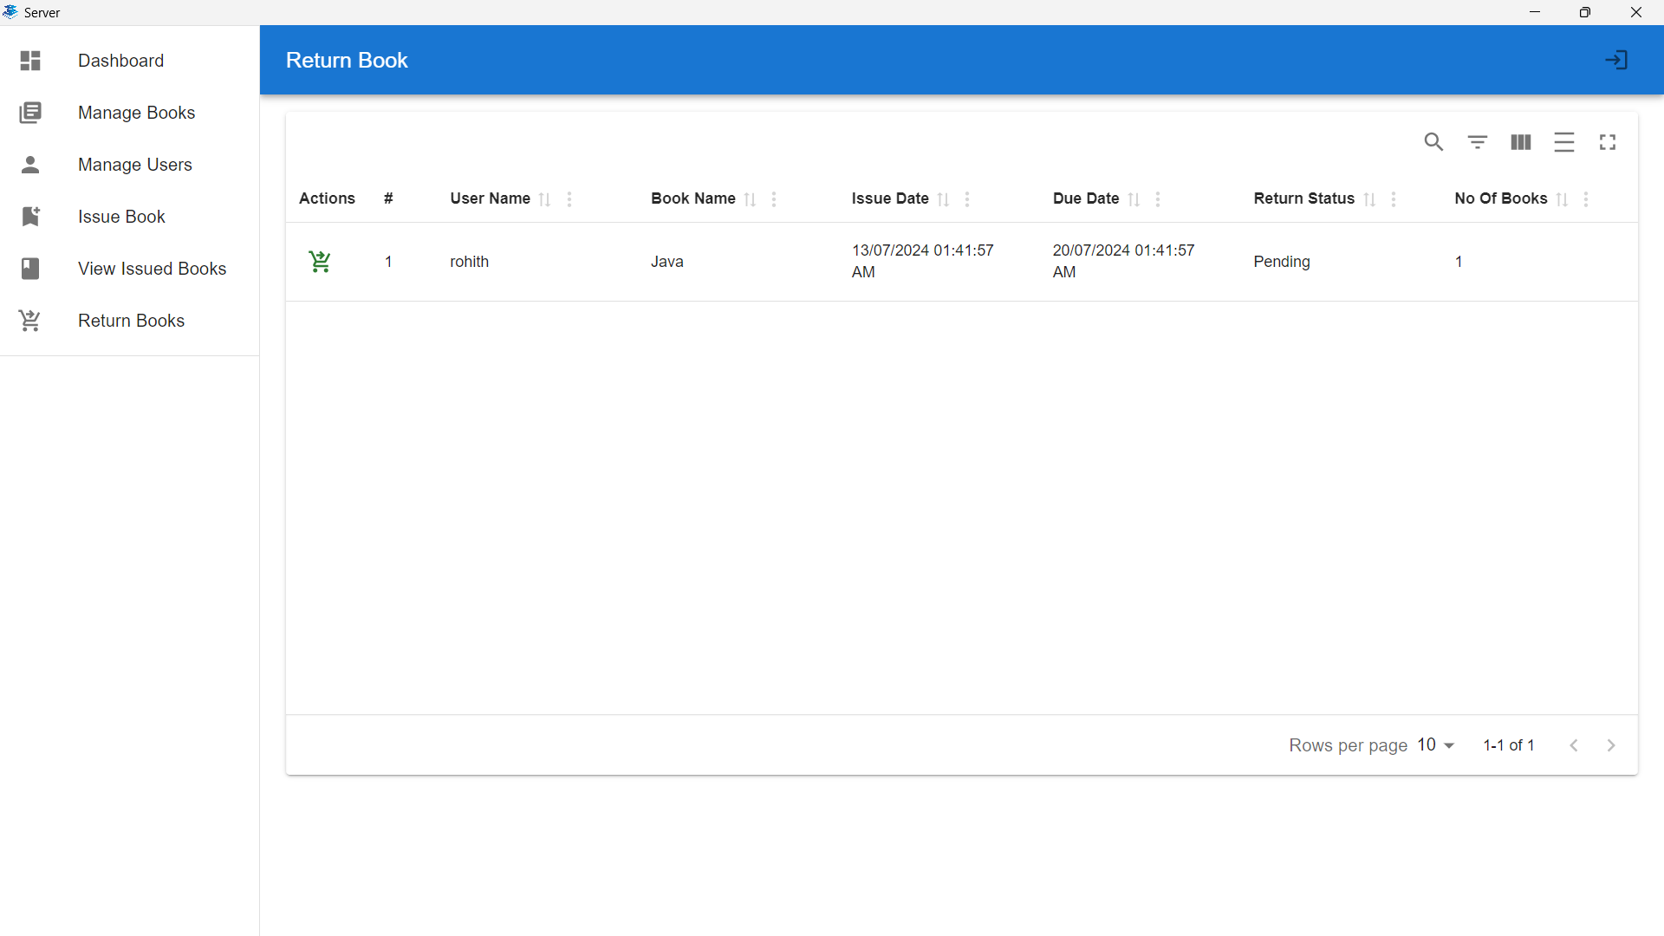
5
Return Book

Slide 13

6
Future Enhancement
Develop a mobile application for users to access library services on-the-go.
Enhancing it with more analytical tools for better track of resources.
Building a Client side interface on desktop for Users.

Slide 14

7
Conclusion
The Library Management System (LMS) significantly improves library operations by automating processes and enhancing user experience.
Integration of advanced technologies like React, Node.js, TypeScript, and Firebase ensures efficiency, scalability, and security.
Future enhancements will further streamline library management and provide additional value to users.

Slide 15
Thank You

